Slide 1


PLEDGE TO PROGRESS Sustainability Hackathon
Sponsored By
Your Team Name : Go Green Techies
Your team bio : Aditya Kumar Tripathi
Vickey saini
Shreesh Jain
Nitisha
Date :22-04-2023

Slide 2
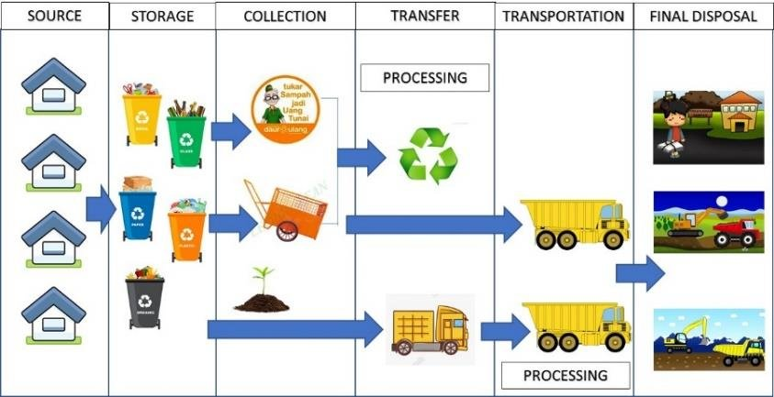
Problem Statement?
Environmental degradation and resource depletion, with waste generation?
Environmental degradation and resource depletion are significant global challenges that are closely linked to the generation of waste. As the global population grows and economies continue to develop, the amount of waste generated increases, which can result in the depletion of resources and harm to the environment.
Landfills and soil pollution: When waste is disposed of in landfills, it can lead to soil pollution. Landfills can contaminate nearby soil and water sources with hazardous chemicals and heavy metals
2. Water pollution: Waste generation is a major contributor to water pollution. Improper disposal of waste can lead to the release of toxins and chemicals into rivers, lakes, and oceans
Greenhouse gas emissions: The disposal of waste also contributes to greenhouse gas emissions, which are a major driver of climate change
Depletion of natural resources: Waste generation is also linked to the depletion of natural resources. The production and disposal of goods and materials require

Slide 3
Solution:-
To address the challenges of environmental degradation and resource depletion caused by waste generation, there are several potential solutions that can be implemented. These solutions include:
Reduce waste generation: One key solution is to reduce the amount of waste generated. This can be done through measures such as reducing packaging, promoting reusable products, and encouraging consumers to make sustainable choices.
Improve waste management practices: Improving waste management practices is another crucial solution. This can include implementing recycling programs, developing effective waste collection and disposal systems, and reducing the amount of waste sent to landfills.
Promote sustainable consumption and production patterns: To address the root causes of waste generation, it is important to promote sustainable consumption and production patterns. This can be done through measures such as encouraging green procurement policies, promoting circular economy models, and supporting sustainable production practices.
. Develop innovative waste management technologies: Innovative technologies can also be developed to help manage waste in a more sustainable way. This can include new recycling technologies, waste-to-energy systems, and advanced landfill management practices.
. Educate and engage the public: Finally, education and engagement are critical to promoting sustainable waste management practices. This can involve educating the public about the impact of waste generation and providing information about sustainable choices, as well as engaging communities in waste reduction and management initiatives.Overall,
addressing the challenges of environmental degradation and resource depletion caused by waste generation will require a combination of solutions. By reducing waste generation, improving waste management practices, promoting sustainable consumption and production patterns,.
:

Slide 4
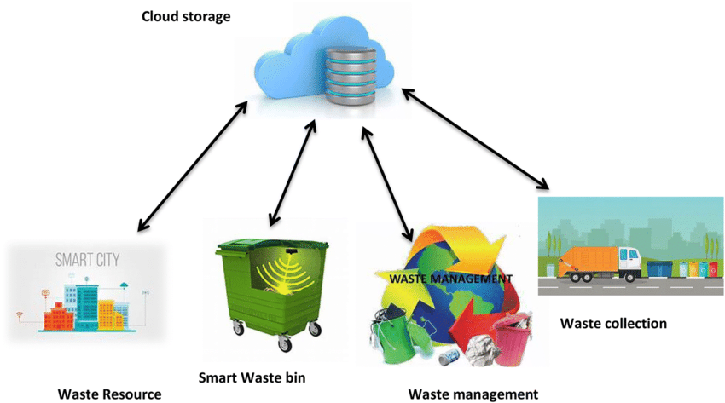
Pre-Requisite
Develop a sustainable business model that integrates social and environmental impact into core operations and decision-making processesImplement circular economy principles to reduce waste and increase resource efficiencyLeverage renewable energy sources and minimize carbon emissions in operations and supply chainPartner with suppliers and customers to improve sustainability across the value chainInvest in employee training and development to promote sustainability awareness and skills.
Cloud Technology and Microsoft Cloud for Sustainability, organizations can measure, monitor, and optimize their energy, water, and waste usage to reduce their environmental impact. The cloud technology can be used to collect and analyze data from sensors

Slide 5
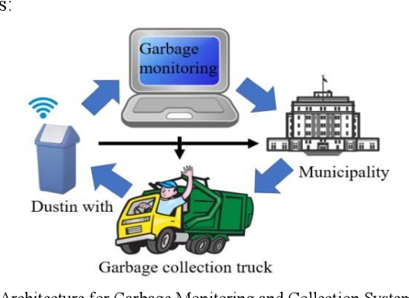
Tools or resources
Azure tools or resources which are likely to be used by you for the prototype, if your idea gets selected a) Azure Data, Analytics and AI capabilities can be leveraged to build analysis, prediction, and forecasting capabilities for sustainability goals. b) By integrating data from various sources, including sensors and IoT devices, and using AI and machine learning algorithms, organizations can gain insights into their environmental impact, c) identify areas for improvement, and forecast future sustainability trends. d) This can help organizations make data-driven decisions to reduce their environmental footprint and achieve their sustainability goals. e) Azure also provides powerful reporting and dashboarding capabilities to visualize and communicate sustainability data to stakeholders, enabling them to track progress and make informed decisions.

Slide 6
Supporting Functional Documents
Waste Management Plan: This document would outline the goals and objectives of the waste management reorganization project, as well as the specific steps that will be taken to achieve those goals. It could include sections on waste reduction, recycling, composting, and disposal.
a) Standard Operating Procedures (SOPs): SOPs would detail the specific procedures that employees must follow in order to properly manage waste. This could include guidelines for sorting and separating different types of waste, procedures for disposing of hazardous waste, and instructions for maintaining equipment.
Training Manual:
A training manual would provide employees with the knowledge and skills they need to properly manage waste. It could include sections on waste reduction, recycling, composting, and disposal, as well as hands-on training exercises and assessments to ensure that employees have mastered the necessary skills.
c) Reporting and Monitoring System: A reporting and monitoring system would allow the waste management team to track progress and identify areas for improvement. This could include regular audits of waste management practices, data collection on waste generation and disposal, and metrics for measuring the effectiveness of different waste management strategies.
d) Communication Plan: A communication plan would outline the strategies that will be used to communicate with employees, customers, and other stakeholders about the waste management reorganization. This could include newsletters, social media updates, and other forms of outreach to ensure that everyone is aware of the changes and their role in implementing them.
When developing these documents, it's important to consider the specific needs and goals of your organization, as well as any relevant regulatory requirements or industry standards. Additionally, these documents should be updated regularly to reflect changes in waste management practices and emerging trends in the field.

Slide 7
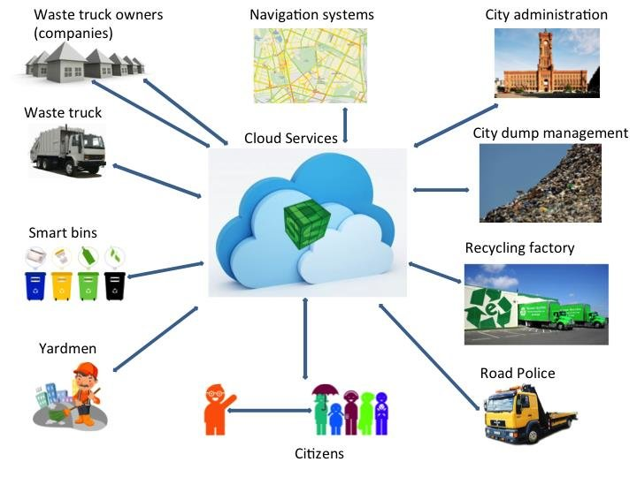
Key Differentiators & Adoption Plan
Customizable and Scalable: A waste management
system that can be customized to meet the specific
needs of an organization is a key differentiator.
b) User-Friendly: A user-friendly system that is easy
to use and understand is a key differentiator.
c) ntegration with other Systems: The ability to
integrate with other systems, such as enterprise
resource planning (ERP) Systems
d)Real-Time Reporting: A waste management
system that provides real-time reporting can
be a keydifferentiator.

Slide 8
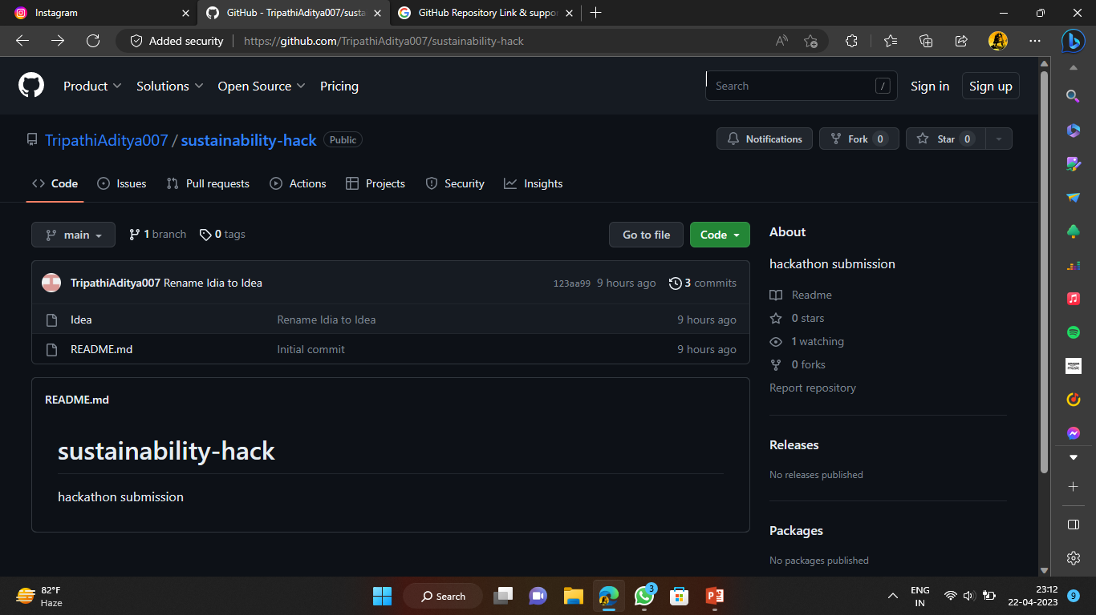
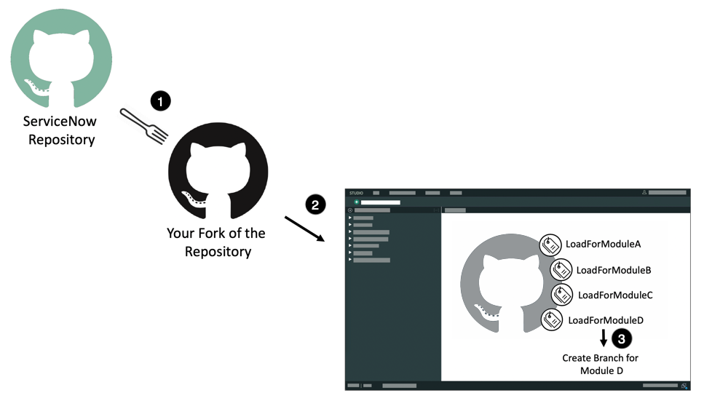
GitHub Repository Link & supporting diagrams, screenshots, if any
https://github.com/TripathiAditya007/sustainability-hack

Slide 9
Thank You
Team member names :-
Aditya Kumar Tripathi
Vickey saini
Shreesh Jain
Nitisha

